Slide 1

OneHealth Nexus: Large-Scale NLP and Temporal Knowledge Graphs for Emerging Disease Intelligence
B.Tech (AIDS)
UG-III (V-Semester)
Subject Coordinator
Dr. Ranjit Panigrahi​
(Associate Professor)​​
Dr. Barkha Singh​
(Assistant Professor​)
​
Presented By:
Anagha Manoj (DL.AI.U4AID24105)
Mimansha Goyal (DL.AI.U4AID24123)
Tanvi Bhardwaj (DL.AI.U4AID24136)
Kundurthi Abhiram (DL.AI.U4AID24144)
AMRITA VISHWA VIDYAPEETHAM, DELHI NCR, FARIDABAD
Department of Artificial Intelligence & Data Science (AIDS)

Slide 2

CONTENTS
Problem Statement
Literature Review
Previous Work
Objectives of the project
Proposed Methodology
Timeline
Novelty
Future scope
References

Slide 3
Problem Statement
Human, animal, and environmental health information is distributed across isolated data sources.
Scientific literature, veterinary reports, environmental bulletins, and public-health records contain valuable but disconnected signals.
Existing systems often analyze these domains independently, making cross-domain relationships difficult to identify.
Emerging threats such as new pathogen–host associations, geographic spread, and environment-linked risks may remain hidden across individual datasets.
There is a need for an integrated, temporal, and automated intelligence framework that can connect these signals and detect emerging risks early.

Slide 4
Literature Review
Developing One Health Surveillance Systems — ScienceDirect, 2023 [1]
Focuses on: Proposes cross-sector data, analysis, and communication workflows linking human, animal, and environmental health.
Gap: Conceptual/organizational framework; does not define a scalable NLP or data-engineering pipeline for extracting and linking information from unstructured text.
2. Wu — COVID-19 Patient Information Knowledge Graph, 2021 [2]
Focuses on: Uses NLP + Neo4j to extract infection events, patient locations, and temporal/spatial relationships.
Gap: Focused on human patients and contact events; lacks pathogen–host–environment relationships and formal temporal graph modeling.
3. Epidemiological Knowledge Graph from WHO Disease Outbreak News (eKG), 2025 [3]
Focuses on: Uses multiple LLMs to extract epidemiological information from WHO Disease Outbreak News and maintain a continuously updated knowledge graph.
Gap: Relies on a single, curated human-health source and does not integrate primary veterinary or environmental documents.
4. e-Outbreak Platform — 2020 [4]
Focuses on: Combines structured/semi-structured outbreak data, statistical analysis, and knowledge graphs for investigation and contact tracing.
Gap: Designed mainly for known-case investigation, with limited exploratory NLP and less emphasis on large-scale discovery of emerging patterns.

Slide 5
Previous Work
HealthMap — Automated Disease Surveillance
Organization: Boston Children's Hospital
Aggregates multilingual online, news, expert and official sources for disease surveillance.
Uses NLP to identify diseases, locations and related outbreak information.
Includes human and animal diseases as well as some environmental risks.
Gap: Primarily designed as an event/alert surveillance system, rather than a temporal knowledge graph for discovering complex cross-domain relationships.
BlueDot — Infectious Disease Intelligence
Company: BlueDot
Uses AI to monitor multilingual global sources for infectious-disease threats.
Provides outbreak alerts, structured intelligence, risk assessments and forecasting.
Incorporates contextual factors such as disease spread and vulnerability.
Gap: Focuses on infectious-disease intelligence and forecasting, rather than building an open-ended temporal entity–relationship graph from heterogeneous One Health text.
EPIWATCH — Early Epidemic Intelligence
Organization: University of New South Wales / Kirby Institute
Uses AI and open-source data to detect early epidemic signals.
Provides real-time situational awareness, dashboards and curated intelligence.
Supports ingestion of additional data streams for surveillance.
Gap: Strong in early-warning surveillance, but not centered on constructing a temporal knowledge graph linking human, animal and environmental entities extracted from text.

Slide 6
Objective of the Project
To collect and integrate heterogeneous textual data from scientific, veterinary, public-health, environmental, and disease-surveillance sources.
To develop a scalable Big Data preprocessing pipeline using distributed processing for cleaning, deduplication, normalization, and metadata extraction.
To extract and normalize cross-domain relationships among human, animal, pathogen, disease, environmental, spatial, and temporal entities.
To construct a temporal One Health Knowledge Graph representing entities, relationships, time, location, and source provenance.
To analyze spatiotemporal patterns including disease trends, pathogen frequency changes, geographic expansion, host changes, and cross-domain associations.
To develop an interpretable emerging-signal detection mechanism using temporal, spatial, source, and cross-domain characteristics to identify potential disease-intelligence signals.
To develop an evidence-linked visualization dashboard for exploring the knowledge graph, temporal trends, geographic patterns, emerging signals, and their supporting source documents.

Slide 7
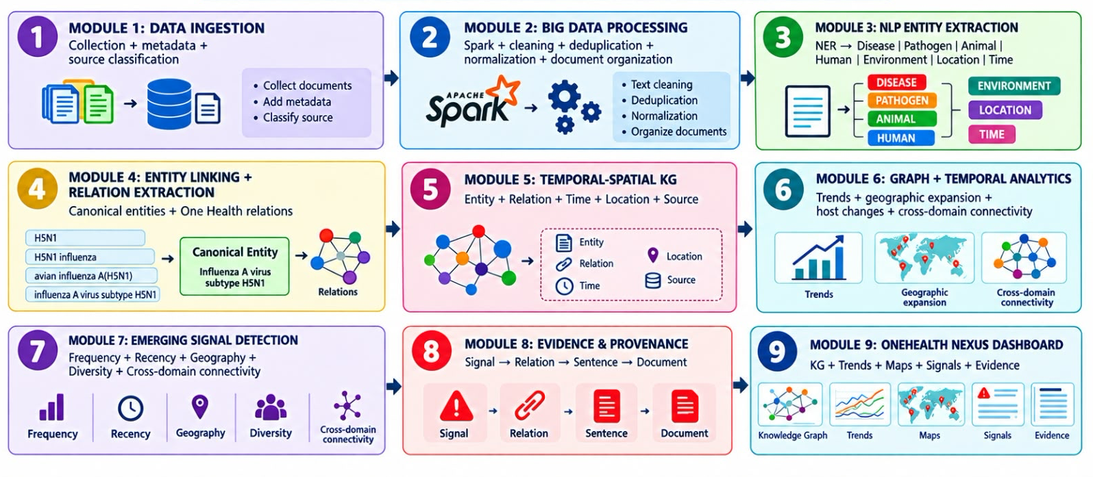
Proposed Methodology

Slide 8
Novelty
True Tri-Domain Integration
Traditional outbreak detection platforms focus primarily on human health indicators and media reports.
One Health Nexus elevates animal, human, and environmental entities to first-class graph nodes rather than secondary metadata, unlocking genuine cross-domain link discovery.
Dynamic Temporal Knowledge Graphs
Replaces static knowledge snapshots with a continuously versioned temporal graph.
Tracks relationship drift such as pathogens acquiring new hosts or expanding into novel territories to learn transmission decay, recurrence, and evolutionary pathways.
Cross-Silo Weak Signal Synthesis
Connects fragmented, non-obvious multi-hop indicators scattered across unstructured literature.
Uncovers complex causal chains such as regional deforestation leading to bat migration, which results in livestock exposure and ultimately triggers human case clusters that manual surveillance cannot link in time.
Proactive Emerging-Signal Detection
Goes beyond passive querying to actively detect critical relationship shifts that warrant immediate public-health attention.
Combines automated information extraction, structured knowledge representation, and temporal graph analysis to generate early surveillance signals.

Slide 9
Timeline
Week 1 — Data Collection
Multi-domain data gathering
Human, animal & environmental sources
Week 1 — Data Preprocessing
Cleaning & normalization
Data structuring
Week 2 — NLP Extraction
Entity recognition
Relationship & temporal extraction
Week 3 — Knowledge Graph
Temporal graph construction
Cross-domain entity linking
Week 3 — Signal Detection
Pattern & anomaly detection
Emerging risk identification
Week 4 — Dashboard
Insights & monitoring
Interactive visualization

Slide 10
Future scope
Improve transparency and analyst trust
Multilingual NLP
Extend the pipeline beyond English
Capture region-specific veterinary and environmental reports
Improve coverage across diverse geographic regions
Real-Time Streaming
Move from batch processing to continuous data ingestion
Enable near-real-time monitoring and anomaly detection
Support faster public-health alerts
Structured Data Integration
Combine text-derived knowledge graphs with structured surveillance data
Integrate sources such as WOAH/OIE databases and climate feeds
Enable richer, hybrid risk detection
Autonomous Multi-Agent Verification
Deploy specialized AI agents for independent fact verification
Cross-check low-confidence social and journalistic signals
Validate leads against scientific literature before alerts
Explainable Detection
Generate a human-readable rationales for every flagged anomaly
Trace alerts back to relevant documents, entities, and relationships

Slide 11
References:
[1] One Health High-Level Expert Panel (OHHLEP) et al., “Developing One Health surveillance systems,” One Health, vol. 17, Art. no. 100617, 2023, doi: 10.1016/j.onehlt.2023.100617.
[2] J. Wu, “Construct a Knowledge Graph for China Coronavirus (COVID-19) Patient Information Tracking,” Risk Management and Healthcare Policy, vol. 14, pp. 4321–4337, 2021, doi: 10.2147/RMHP.S309732.
[3] S. Consoli, P. Coletti, P. V. Markov, L. Orfei, I. Biazzo, L. Schuh, N. Stefanovitch, L. Bertolini, M. Ceresa, and N. I. Stilianakis, “An epidemiological knowledge graph extracted from the World Health Organization’s Disease Outbreak News,” Scientific Data, vol. 12, Art. no. 970, 2025, doi: 10.1038/s41597-025-05276-2.
[4] W. J. Chen, S.-Y. Yang, J.-C. Chang, W.-C. Cheng, T.-P. Lu, Y.-N. Wang, M.-H. Juan, R.-T. Hsu, S.-R. Huang, J.-J. Tu, P.-C. Wang, V. W.-S. Feng, and P.-Z. Chang, “Development of a semi-structured, multifaceted, computer-aided questionnaire for outbreak investigation: e-Outbreak Platform,” Biomedical Journal, vol. 43, no. 4, pp. 318–324, 2020, doi: 10.1016/j.bj.2020.06.007.

Slide 12
THANK
YOU

